Slide 1
INTRODUCTION TO CLASSIFICATION
NAÏVE BAYES

Slide 2
Classification
As we discussed earlier
  If the designated attribute is categorical, the task is called classification.
  Classification is one form of prediction, where the value to be predicted is a label.
  A hospital may want to classify medical patients into those who are at high, medium or low risk
  We may wish to classify a student project as distinction, merit, pass or fail
  Nearest Neighbour Matching, Classification Rules, Classification Tree, …

Slide 3
Classification
Dividing up objects so that each is assigned to one of a number of mutually exhaustive and exclusive categories known as classes (recall Class Attribute).
Examples
  people who are at high, medium or low risk of acquiring a certain illness
  student projects worthy of a distinction, merit, pass or fail grade
  the likelihood of rain the next day for a weather forecast (very likely, likely, unlikely, very unlikely)
Some classifiers deal only with categorical attributes, some only with continuous attributes while some work on both
Notes:
The term
‘mutually exhaustive and exclusive’ simply means that each object must be
assigned to precisely one class, i.e. never to more than one and never to no
class at all.

Slide 4
Naïve Bayes Classifiers
Does not use rules, a decision tree or any other explicit representation of the classifier
It uses probability theory to find the most likely of the possible classifications
When all attributes are categorical

Slide 5
Naïve Bayes Classifiers
We have to predict any one of the four events from the class attribute
To predict event which is train timing, additional information are needed which are included in the data using additional attributes – day, season, wind and rain

Slide 6
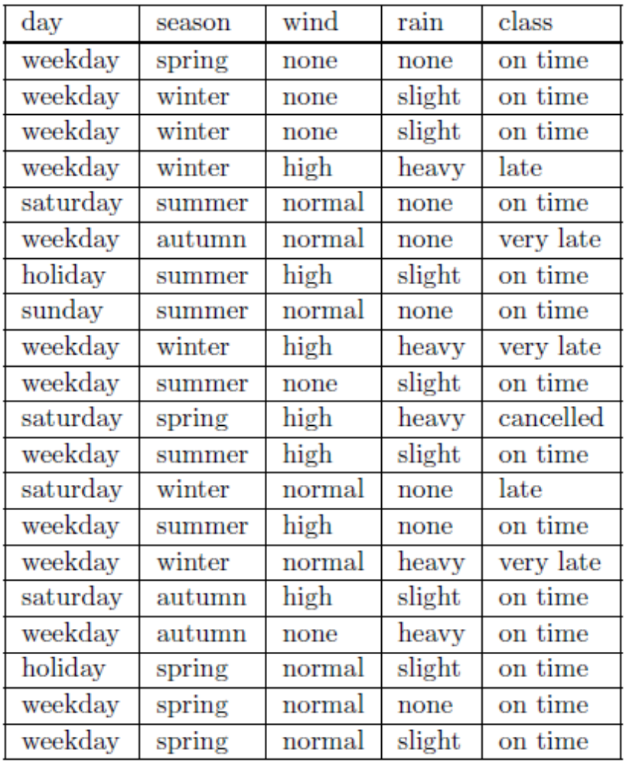
Naïve Bayes Classifiers
Here classifications are
  E1 - cancelled, train cancelled
  E2 - very late, train ten minutes or more late
  E3 - late, train less than ten minutes late and
  E4 - on time, train on time or early

Slide 7
Naïve Bayes Classifiers
One straightforward way is just to look at the frequency of each of the classifications in the training set and choose the most common one.

Slide 8
Naïve Bayes Classifiers
One straightforward way is just to look at the frequency of each of the classifications in the training set and choose the most common one.
P(E1) = P(cancelled) = 1/20 = 0.05
  The probability of event E1 (cancelled) is 0.05

Slide 9
Naïve Bayes Classifiers
One straightforward way is just to look at the frequency of each of the classifications in the training set and choose the most common one.
P(E1) = P(cancelled) = 1/20 = 0.05
  The probability of event E1 (cancelled) is 0.05
P(E2) = P(very late) = 3/20 = 0.10

Slide 10
Naïve Bayes Classifiers
One straightforward way is just to look at the frequency of each of the classifications in the training set and choose the most common one.
P(E1) = P(cancelled) = 1/20 = 0.05
  The probability of event E1 (cancelled) is 0.05
P(E2) = P(very late) = 3/20 = 0.10
P(E3) = P(late) = 2/20 = 0.15
P(E4) = P(on time) = 14/20 = 0.7
Instead of P(E4), we can write P(on time) or P(class = on time)

Slide 11
Naïve Bayes Classifiers
Making decision just based on the probability of class value is not a good choice.
The flaw in this approach is, of course, that all unseen instances will be classified in the same way, in this case as on time.
The aim is to make correct predictions as often as possible
Other information greatly influence the decision like
if season = winter then P(on time) = 2/6 = 0.33
‘the probability that the class is on time given that the season is winter’

Slide 12
Naïve Bayes Classifiers
To make effective decision, Naïve Bayes Classifier uses probability information which involve additional attributes information
Prior Probability
  The probability of the train being on time, calculated using the frequency of on time in the training set divided by the total number of instances is known as the prior probability.
  In this case P(class = on time) = 14/20 = 0.7

Slide 13
Naïve Bayes Classifiers
Conditional/Posterior Probability
  The probability of an event occurring if we know that an attribute has a particular value (or that several variables have particular values) is called the conditional probability of the event occurring and is written as, e.g. P(class = on time | season = winter).
  P(class = on time | season = winter) = 2/6 = 0.33
  P(class = late | season = winter) = 2/6 = 0.33

Slide 14
Naïve Bayes Classifiers
Conditional/Posterior Probability
  The probability of an event occurring if we know that an attribute has a particular value (or that several variables have particular values) is called the conditional probability of the event occurring and is written as, e.g. P(class = on time | season = winter).
  P(class = on time | season = winter) = 2/6 = 0.33
  P(class = late | season = winter) = 2/6 = 0.33
  P(class = very late | season = winter) = 2/6 = 0.33
  P(class = cancelled | season = winter) = 0/6 = 0

Slide 15
Naïve Bayes Classifiers
To calculate the most likely classification for the ‘unseen’ instance given previously we could calculate the probability of
P(class = on time | day = weekday and season = winter
and wind = high and rain = heavy)
The Naïve Bayes algorithm gives us a way of combining the prior probability and conditional probabilities in a single formula, which we can use to calculate the probability of each of the possible classifications in turn. Having done this we choose the classification with the largest value.

Slide 16
Naïve Bayes Classifiers
Given a set of k mutually exclusive and exhaustive classifications c₁, c₂, . . . , c_{k}, which have prior probabilities P(c₁), P(c₂), . . . , P(c_{k}), respectively, and n attributes a₁, a₂, . . . , a_{n} which for a given instance have values v₁, v₂, . . . , v_{n} respectively
The posterior probability of class c_{i} occurring for the specified instance can be shown to be proportional to
P( c_{i} ) × P( a₁ = v₁ and a₂ = v₂ . . . and a_{n} = v_{n} | c_{i} )

Slide 17
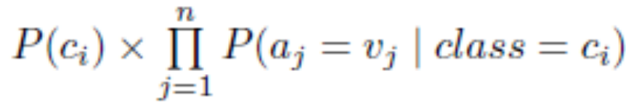
Naïve Bayes Classifiers
Making the assumption that the attributes are independent, the value of this expression can be calculated using the product
P( c_{i} ) × P( a₁ = v₁ | c_{i} ) × P( a₂ = v₂ | c_{i} ) × . . .× P( a_{n} = v_{n} | c_{i} )
We calculate this product for each value of i from 1 to k and choose the classification that has the largest value.
The above formula combines the prior probability of ci with the values of the n possible conditional probabilities involving a test on the value of a single attribute.
It is often written as

Slide 18
Naïve Bayes Classifiers
Prior Probabilities
  P(class = on time) = 14/20 = 0.7
  P(class = late) = 2/20 = 0.10
  P(class = very late) = 3/20 = 0.15
  P(class = cancelled) = 1/20 = 0.05
 | class = on time | class = late | class = very late | class = cancelled
prior probability | 14/20 = 0.7 | 2/20 = 0.10 | 3/20 = 0.15 | 1/20 = 0.05

Slide 19
Naïve Bayes Classifiers
Conditional Probabilities
  P(day = weekday | class = on time) = 9/14 = 0.65
 | class = on time | class = late | class = very late | class = cancelled
day = weekday | 9/14 = 0.65

Slide 20
Naïve Bayes Classifiers
Conditional Probabilities
  P(day = weekday | class = on time) = 9/14 = 0.65
  P(day = weekday | class = late) = 1/2 = 0. 5
 | class = on time | class = late | class = very late | class = cancelled
day = weekday | 9/14 = 0.65 | 1/2 = 0. 5

Slide 21
Naïve Bayes Classifiers
Conditional Probabilities
  P(day = weekday | class = on time) = 9/14 = 0.65
  P(day = weekday | class = late) = 1/2 = 0.5
  P(day = weekday | class = very late) = 3/3 = 1
  P(day = weekday | class = cancelled) = 0/1 = 0
 | class = on time | class = late | class = very late | class = cancelled
day = weekday | 9/14 = 0.65 | 1/2 = 0. 5 | 3/3 = 1 | 0/1 = 0

Slide 22
Naïve Bayes Classifiers
 | class = on time | class = late | class = very late | class = cancelled
day = weekday | 9/14 = 0.65 | 1/2 = 0. 5 | 3/3 = 1 | 0/1 = 0
day = saturday
day = sunday
day = holiday

Slide 23
Naïve Bayes Classifiers
 | class = on time | class = late | class = very late | class = cancelled
season = spring | 4/14 = 0.29 | 0/2 = 0 | 0/3 = 0 | 1/1 = 1
season = summer
season = autumn
season = winter

Slide 24
Naïve Bayes Classifiers
 | class = on time | class = late | class = very late | class = cancelled
wind = none | 5/14 = 0.36 | 0/2 = 0 | 0/3 = 0 | 0/1 = 0
wind = high
wind = normal

Slide 25
Naïve Bayes Classifiers
 | class = on time | class = late | class = very late | class = cancelled
rain = none | 5/14 = 0.36 | 1/2 = 0.5 | 1/3 = 0.33 | 0/1 = 0
rain = slight
rain = heavy

Slide 26
Naïve Bayes
 | Class = on time | Class = late | Class = very late | Class = cancelled
day = weekday | 9/14 = 0.65 | 1/2 = 0. 5 | 3/3 = 1 | 0/1 = 0
day = saturday | 2/14 = 0.14 | 1/2 = 0.5 | 0/3 = 0 | 1/1 = 1
day = sunday | 1/14 = 0.07 | 0/2 = 0 | 0/3 = 0 | 0/1 = 0
day = holiday | 2/14 = 0.14 | 0/2 = 0 | 0/3 = 0 | 0/1 = 0
season = spring | 4/14 = 0.29 | 0/2 = 0 | 0/3 = 0 | 1/1 = 1
season = summer | 6/14 = 0.43 | 0/2 = 0 | 0/3 = 0 | 0/1 = 0
season = autumn | 2/14 = 0.14 | 0/2 = 0 | 1/3 = 0.33 | 0/1 = 0
season = winter | 2/14 = 0.14 | 2/2 = 1 | 2/3 = 0.67 | 0/1 = 0
wind = none | 5/14 = 0.36 | 0/2 = 0 | 0/3 = 0 | 0/1 = 0
wind = high | 4/14 = 0.29 | 1/2 = 0.5 | 1/3 = 0.33 | 1/1 = 1
wind = normal | 5/14 = 0.36 | 1/2 = 0.5 | 2/3 = 0.67 | 0/1 = 0
rain = none | 5/14 = 0.36 | 1/2 = 0.5 | 1/3 = 0.33 | 0/1 = 0
rain = slight | 8/14 = 0.57 | 0/2 = 0 | 0/3 = 0 | 0/1 = 0
rain = heavy | 1/14 = 0.07 | 1/2 = 0.5 | 2/3 = 0.67 | 1/1 = 1
prior probability | 14/20 = 0.7 | 2/20 = 0.10 | 3/20 = 0.15 | 1/20 = 0.05
We have to calculate posterior probability for each classification using the formula
P( c_{i} ) × P( a₁ = v₁ | c_{i} ) ×
P( a₂ = v₂ | c_{i} ) × . . .× P( a_{n} = v_{n} | c_{i} )
Class with the highest posterior probability is the decision made by the Naïve Bayes Classification

Slide 27
Naïve Bayes
 | Class = on time | Class = late | Class = very late | Class = cancelled
day = weekday | 9/14 = 0.65 | 1/2 = 0. 5 | 3/3 = 1 | 0/1 = 0
day = saturday | 2/14 = 0.14 | 1/2 = 0.5 | 0/3 = 0 | 1/1 = 1
day = sunday | 1/14 = 0.07 | 0/2 = 0 | 0/3 = 0 | 0/1 = 0
day = holiday | 2/14 = 0.14 | 0/2 = 0 | 0/3 = 0 | 0/1 = 0
season = spring | 4/14 = 0.29 | 0/2 = 0 | 0/3 = 0 | 1/1 = 1
season = summer | 6/14 = 0.43 | 0/2 = 0 | 0/3 = 0 | 0/1 = 0
season = autumn | 2/14 = 0.14 | 0/2 = 0 | 1/3 = 0.33 | 0/1 = 0
season = winter | 2/14 = 0.14 | 2/2 = 1 | 2/3 = 0.67 | 0/1 = 0
wind = none | 5/14 = 0.36 | 0/2 = 0 | 0/3 = 0 | 0/1 = 0
wind = high | 4/14 = 0.29 | 1/2 = 0.5 | 1/3 = 0.33 | 1/1 = 1
wind = normal | 5/14 = 0.36 | 1/2 = 0.5 | 2/3 = 0.67 | 0/1 = 0
rain = none | 5/14 = 0.36 | 1/2 = 0.5 | 1/3 = 0.33 | 0/1 = 0
rain = slight | 8/14 = 0.57 | 0/2 = 0 | 0/3 = 0 | 0/1 = 0
rain = heavy | 1/14 = 0.07 | 1/2 = 0.5 | 2/3 = 0.67 | 1/1 = 1
prior probability | 14/20 = 0.7 | 2/20 = 0.10 | 3/20 = 0.15 | 1/20 = 0.05
class = on time
P(class = on time) x
P(day = weekday | class = on time) x
P(season = winter | class = on time) x
P(wind = high | class = on time) x
P(rain = heavy | class = on time)
0.70 × 0.65 × 0.14 × 0.29 × 0.07 = 0.0013

Slide 28
Naïve Bayes
 | Class = on time | Class = late | Class = very late | Class = cancelled
day = weekday | 9/14 = 0.65 | 1/2 = 0. 5 | 3/3 = 1 | 0/1 = 0
day = saturday | 2/14 = 0.14 | 1/2 = 0.5 | 0/3 = 0 | 1/1 = 1
day = sunday | 1/14 = 0.07 | 0/2 = 0 | 0/3 = 0 | 0/1 = 0
day = holiday | 2/14 = 0.14 | 0/2 = 0 | 0/3 = 0 | 0/1 = 0
season = spring | 4/14 = 0.29 | 0/2 = 0 | 0/3 = 0 | 1/1 = 1
season = summer | 6/14 = 0.43 | 0/2 = 0 | 0/3 = 0 | 0/1 = 0
season = autumn | 2/14 = 0.14 | 0/2 = 0 | 1/3 = 0.33 | 0/1 = 0
season = winter | 2/14 = 0.14 | 2/2 = 1 | 2/3 = 0.67 | 0/1 = 0
wind = none | 5/14 = 0.36 | 0/2 = 0 | 0/3 = 0 | 0/1 = 0
wind = high | 4/14 = 0.29 | 1/2 = 0.5 | 1/3 = 0.33 | 1/1 = 1
wind = normal | 5/14 = 0.36 | 1/2 = 0.5 | 2/3 = 0.67 | 0/1 = 0
rain = none | 5/14 = 0.36 | 1/2 = 0.5 | 1/3 = 0.33 | 0/1 = 0
rain = slight | 8/14 = 0.57 | 0/2 = 0 | 0/3 = 0 | 0/1 = 0
rain = heavy | 1/14 = 0.07 | 1/2 = 0.5 | 2/3 = 0.67 | 1/1 = 1
prior probability | 14/20 = 0.7 | 2/20 = 0.10 | 3/20 = 0.15 | 1/20 = 0.05
class = late
0.10 × 0.50 × 1.00 × 0.50 × 0.50 = 0.0125

Slide 29
Naïve Bayes
 | Class = on time | Class = late | Class = very late | Class = cancelled
day = weekday | 9/14 = 0.65 | 1/2 = 0. 5 | 3/3 = 1 | 0/1 = 0
day = saturday | 2/14 = 0.14 | 1/2 = 0.5 | 0/3 = 0 | 1/1 = 1
day = sunday | 1/14 = 0.07 | 0/2 = 0 | 0/3 = 0 | 0/1 = 0
day = holiday | 2/14 = 0.14 | 0/2 = 0 | 0/3 = 0 | 0/1 = 0
season = spring | 4/14 = 0.29 | 0/2 = 0 | 0/3 = 0 | 1/1 = 1
season = summer | 6/14 = 0.43 | 0/2 = 0 | 0/3 = 0 | 0/1 = 0
season = autumn | 2/14 = 0.14 | 0/2 = 0 | 1/3 = 0.33 | 0/1 = 0
season = winter | 2/14 = 0.14 | 2/2 = 1 | 2/3 = 0.67 | 0/1 = 0
wind = none | 5/14 = 0.36 | 0/2 = 0 | 0/3 = 0 | 0/1 = 0
wind = high | 4/14 = 0.29 | 1/2 = 0.5 | 1/3 = 0.33 | 1/1 = 1
wind = normal | 5/14 = 0.36 | 1/2 = 0.5 | 2/3 = 0.67 | 0/1 = 0
rain = none | 5/14 = 0.36 | 1/2 = 0.5 | 1/3 = 0.33 | 0/1 = 0
rain = slight | 8/14 = 0.57 | 0/2 = 0 | 0/3 = 0 | 0/1 = 0
rain = heavy | 1/14 = 0.07 | 1/2 = 0.5 | 2/3 = 0.67 | 1/1 = 1
prior probability | 14/20 = 0.7 | 2/20 = 0.10 | 3/20 = 0.15 | 1/20 = 0.05
class = very late
0.15 × 1.00 × 0.67 × 0.33 × 0.67 = 0.0222

Slide 30
Naïve Bayes
 | Class = on time | Class = late | Class = very late | Class = cancelled
day = weekday | 9/14 = 0.65 | 1/2 = 0. 5 | 3/3 = 1 | 0/1 = 0
day = saturday | 2/14 = 0.14 | 1/2 = 0.5 | 0/3 = 0 | 1/1 = 1
day = sunday | 1/14 = 0.07 | 0/2 = 0 | 0/3 = 0 | 0/1 = 0
day = holiday | 2/14 = 0.14 | 0/2 = 0 | 0/3 = 0 | 0/1 = 0
season = spring | 4/14 = 0.29 | 0/2 = 0 | 0/3 = 0 | 1/1 = 1
season = summer | 6/14 = 0.43 | 0/2 = 0 | 0/3 = 0 | 0/1 = 0
season = autumn | 2/14 = 0.14 | 0/2 = 0 | 1/3 = 0.33 | 0/1 = 0
season = winter | 2/14 = 0.14 | 2/2 = 1 | 2/3 = 0.67 | 0/1 = 0
wind = none | 5/14 = 0.36 | 0/2 = 0 | 0/3 = 0 | 0/1 = 0
wind = high | 4/14 = 0.29 | 1/2 = 0.5 | 1/3 = 0.33 | 1/1 = 1
wind = normal | 5/14 = 0.36 | 1/2 = 0.5 | 2/3 = 0.67 | 0/1 = 0
rain = none | 5/14 = 0.36 | 1/2 = 0.5 | 1/3 = 0.33 | 0/1 = 0
rain = slight | 8/14 = 0.57 | 0/2 = 0 | 0/3 = 0 | 0/1 = 0
rain = heavy | 1/14 = 0.07 | 1/2 = 0.5 | 2/3 = 0.67 | 1/1 = 1
prior probability | 14/20 = 0.7 | 2/20 = 0.10 | 3/20 = 0.15 | 1/20 = 0.05
class = cancelled
0.05 × 0.00 × 0.00 × 1.00 × 1.00 = 0.0000

Slide 31
Naïve Bayes
 | Class = on time | Class = late | Class = very late | Class = cancelled
day = weekday | 9/14 = 0.65 | 1/2 = 0. 5 | 3/3 = 1 | 0/1 = 0
day = saturday | 2/14 = 0.14 | 1/2 = 0.5 | 0/3 = 0 | 1/1 = 1
day = sunday | 1/14 = 0.07 | 0/2 = 0 | 0/3 = 0 | 0/1 = 0
day = holiday | 2/14 = 0.14 | 0/2 = 0 | 0/3 = 0 | 0/1 = 0
season = spring | 4/14 = 0.29 | 0/2 = 0 | 0/3 = 0 | 1/1 = 1
season = summer | 6/14 = 0.43 | 0/2 = 0 | 0/3 = 0 | 0/1 = 0
season = autumn | 2/14 = 0.14 | 0/2 = 0 | 1/3 = 0.33 | 0/1 = 0
season = winter | 2/14 = 0.14 | 2/2 = 1 | 2/3 = 0.67 | 0/1 = 0
wind = none | 5/14 = 0.36 | 0/2 = 0 | 0/3 = 0 | 0/1 = 0
wind = high | 4/14 = 0.29 | 1/2 = 0.5 | 1/3 = 0.33 | 1/1 = 1
wind = normal | 5/14 = 0.36 | 1/2 = 0.5 | 2/3 = 0.67 | 0/1 = 0
rain = none | 5/14 = 0.36 | 1/2 = 0.5 | 1/3 = 0.33 | 0/1 = 0
rain = slight | 8/14 = 0.57 | 0/2 = 0 | 0/3 = 0 | 0/1 = 0
rain = heavy | 1/14 = 0.07 | 1/2 = 0.5 | 2/3 = 0.67 | 1/1 = 1
prior probability | 14/20 = 0.7 | 2/20 = 0.10 | 3/20 = 0.15 | 1/20 = 0.05
class = on time
0.70 × 0.64 × 0.14 × 0.29 × 0.07 = 0.0013
class = late
0.10 × 0.50 × 1.00 × 0.50 × 0.50 = 0.0125
class = very late
0.15 × 1.00 × 0.67 × 0.33 × 0.67 = 0.0222
class = cancelled
0.05 × 0.00 × 0.00 × 1.00 × 1.00 = 0.0000
The largest value (0.0222) is for
class = very late

Slide 32
Naïve Bayes Classifiers
The Na¨ıve Bayes approach is a very popular one
However it has a number of potential problems
  It relies on all attributes being categorical
    In practice, many datasets have a combination of categorical and continuous attributes, or even only continuous attributes
    This problem can be overcome by converting the continuous attributes to categorical ones
  If the number of instances with a given attribute/value combination is small
    In the extreme case where it is zero, the posterior probability will inevitably be calculated as zero (for class = cancelled)

Slide 33
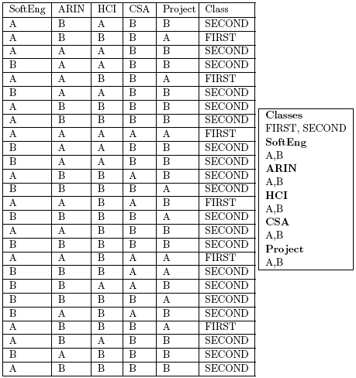
Exercise

